Slide 1








Scalable, Resilient, and Configurable Permissioned Blockchain Fabric
Sajjad Rahnama
Suyash Gupta
Thamir Qadah
Jelle Hellings
Mohammad Sadoghi
Exploratory Systems Lab
University of California Davis

Slide 2










What is Blockchain?
Cryptocurrency
Distributed Ledger
A Transaction
Another Transaction
Bitcoin
Ethereum
XRP Ripple

Slide 3
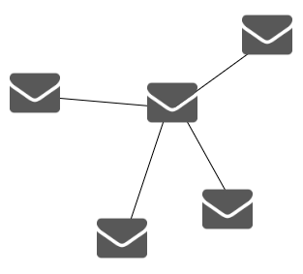






Permissionless vs Permissioned Blockchain
2af5a11
Node 2
60f0a97
Node 1
Communication Based
Computation Based
Node 3
0e7c703a
a91d43b
Node 4
Permissionless
Permissioned
Network Bounded
Energy Limited
Notes:
Cryptocurrencies are called permissionless blockchain while there is another type of blockchain called Permissioned
Permissioned means the identities of participants are known for everyone however they can act malicious or faulty
In permissionless blockchain consensus or agreement on transactions are based on computation and

Slide 4
Practical Byzantine Fault Tolerance (PBFT)
T
Client
Request
Pre-Prepare
O(n)
Prepare
O(n²)
Commit
O(n²)
Reply
Multiple Round of Communication

Slide 5
Design Parameters, Elements, And Components of a Permissioned Blochchains

Slide 6







Parallelization
Execution
Message Processing
Adjustability
User Interface
Scalability
Queueing

Slide 7





Architecture
Interface
Blockchain Core
Web
Dashboard
Monitoring
And
Statistics
Blockchain
Core
Interface and Monitoring

Slide 8

Architecture
Web
Dashboard
Monitoring
And
Statistics
Blockchain
Core

Slide 9



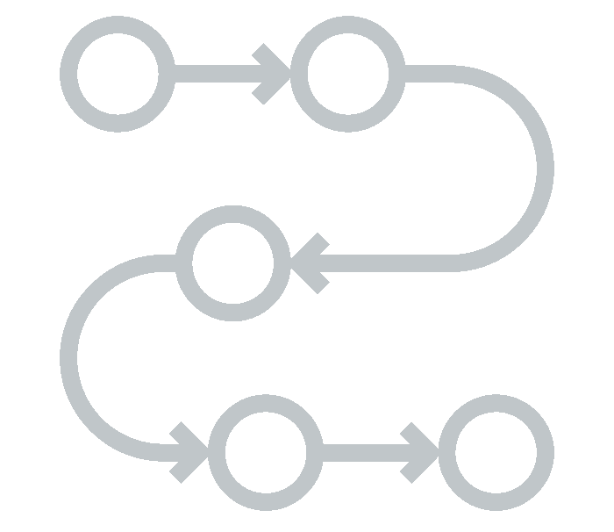





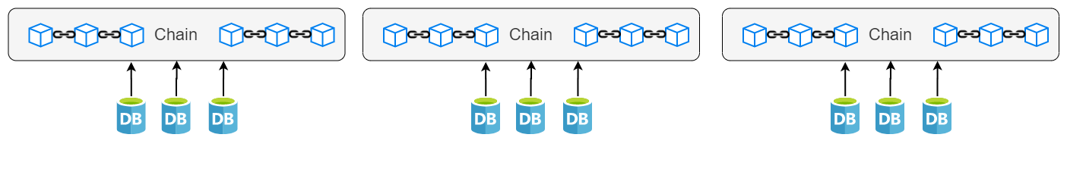
Blockchain Core
Batching and Consensus Threads
Execution
Threads
Output Threads
Input Threads
network

Slide 10


Monitoring And Statistics
Web
Dashboard
Blockchain Core
Secure Tunnel
Secure Tunnel
Scripts in all threads
To Gather Stats
Accumulation and Analysis Scripts

Slide 11
Demonstration Scenarios

Slide 12
Running The System

Slide 13
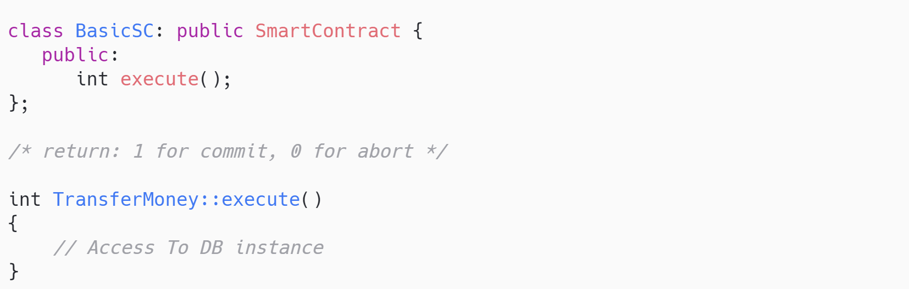
Smart Contracts
A smart contract is a piece of code which executes a
transaction in the blockchain environment

Slide 14
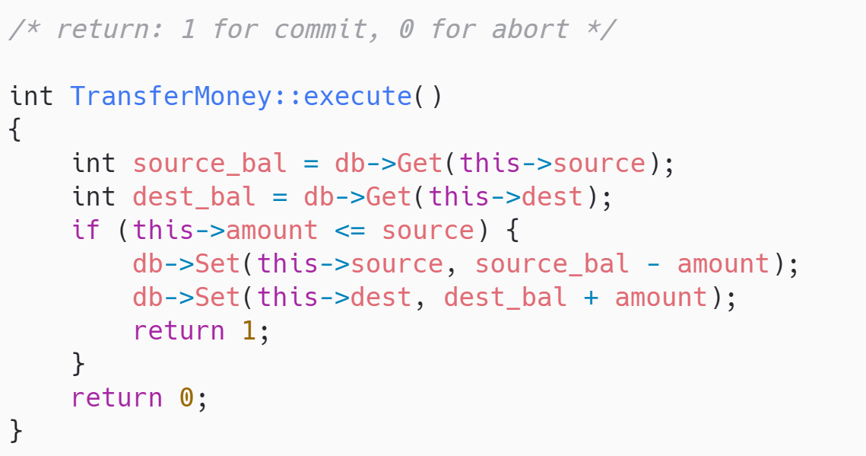
Transfer Money: Smart Contracts

Slide 15
Thank You

